Slide 1
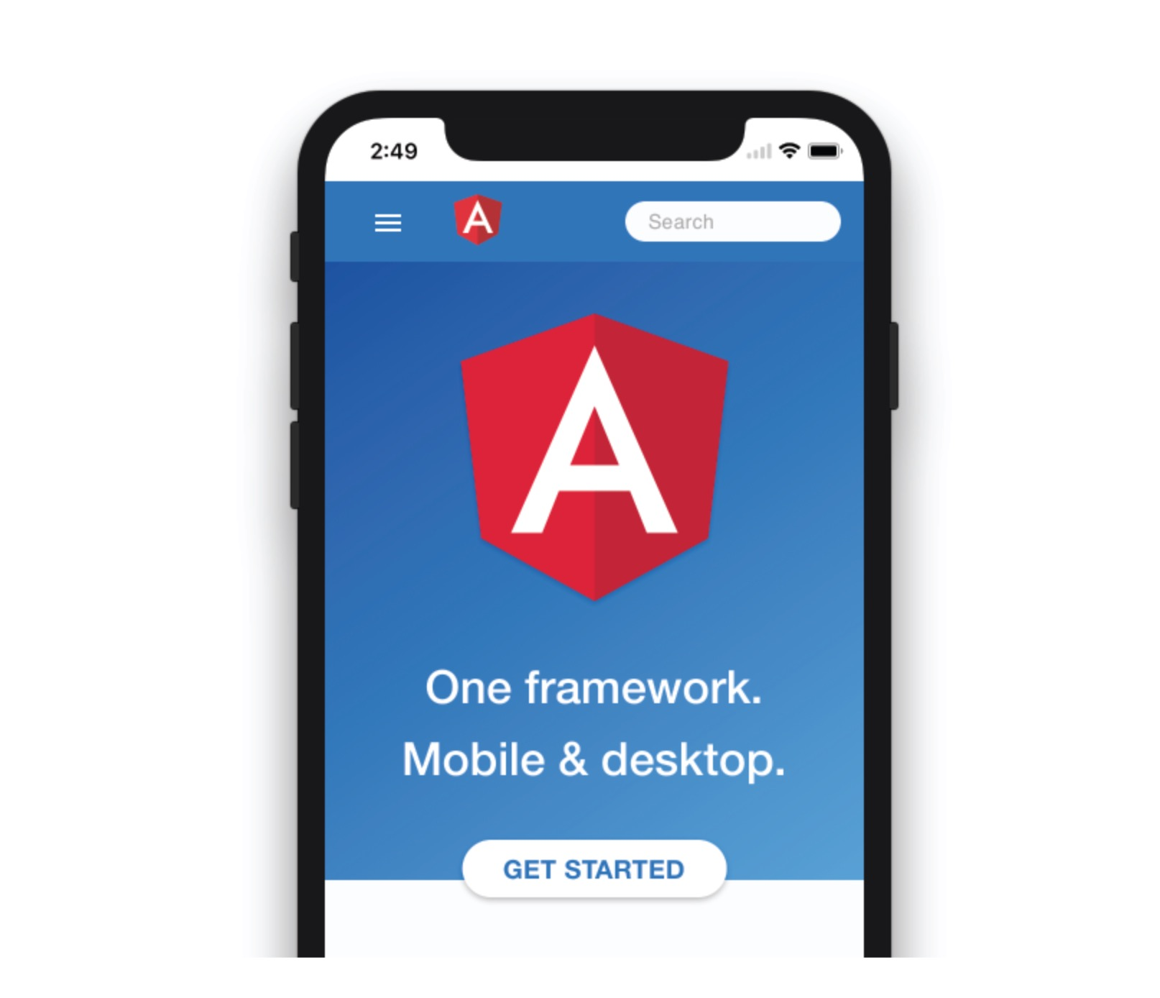

Offline Angular
in Action
ngVikings
2nd , March 2018
Majid Hajian

Slide 2
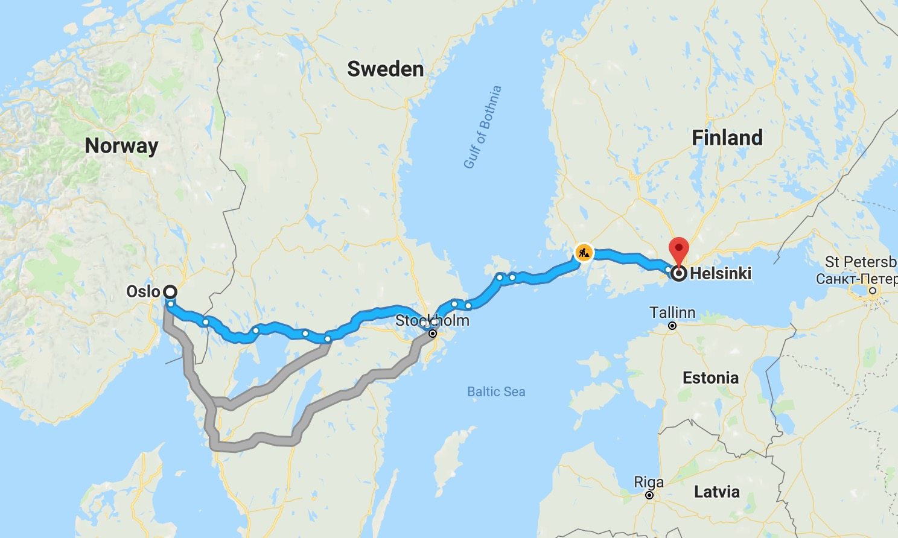


Passionate web developer
Open Source lover and contributor
Public speaker, Organizer
Instructor and trainer
MAJID HAJIAN
@mhadaily

Slide 3
Progressively Enhanced User Experience

Slide 4
Content Overview
App Banner Prompt
Show app banner prompt
when it’s the best time.
Background Sync
Let’s save user data
and sync back with server
Better App Theme
Give your user the best experience
with progressive enhancement
Advanced Cache Strategies
Dive into cache strategies and understating
How they works

Slide 5

BANNER
PROMPT

Slide 6
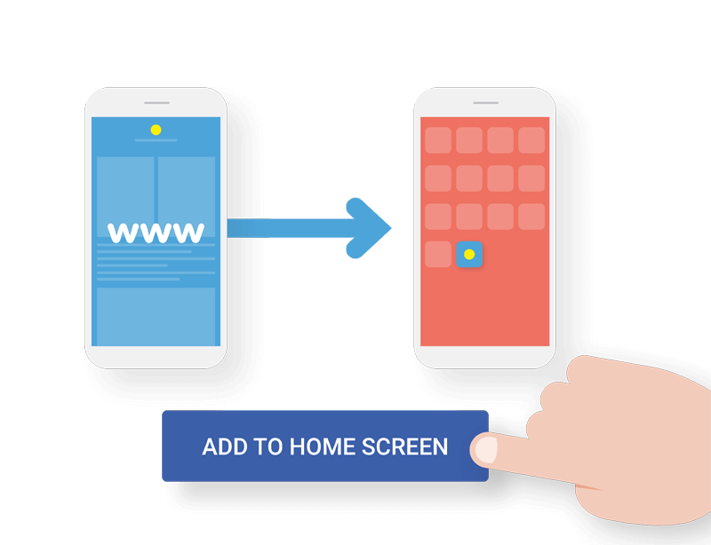
Installable

Slide 7

deferredPrompt(event) {
event.preventDefault();
this.deferredPromptEvent = event;
return false;
}

Slide 8
deferredPrompt(event) {
event.preventDefault();
this.deferredPromptEvent = event;
return false;
}

Slide 9
deferredPrompt(event) {
event.preventDefault();
this.deferredPromptEvent = event;
return false;
}

Slide 10
async ShowDefferedPrompt() {
if (this.deferredPromptEvent) {
(<any>this.deferredPromptEvent).prompt();
const choice = await this.deferredPromptEvent.userChoice;
if (choice.outcome === 'dismissed') {
console.log('installation was cancelled By User');
} else {
console.log('User added to home screen');
}
this.deferredPromptEvent = null;
}
}

Slide 11
async ShowDefferedPrompt() {
if (this.deferredPromptEvent) {
(<any>this.deferredPromptEvent).prompt();
const choice = await this.deferredPromptEvent.userChoice;
if (choice.outcome === 'dismissed') {
console.log('installation was cancelled By User');
} else {
console.log('User added to home screen');
}
this.deferredPromptEvent = null;
}
}

Slide 12
async ShowDefferedPrompt() {
if (this.deferredPromptEvent) {
(<any>this.deferredPromptEvent).prompt();
const choice = await this.deferredPromptEvent.userChoice;
if (choice.outcome === 'dismissed') {
console.log('installation was cancelled By User');
} else {
console.log('User added to home screen');
}
this.deferredPromptEvent = null;
}
}

Slide 13

Better
App Theme

Slide 14
renderer.listen('window', 'online', (e) => this.backOnline(e));
renderer.listen('window', 'offline', (e) => this.goesOffline(e));

Slide 15
renderer.listen('window', 'online', (e) => this.backOnline(e));
renderer.listen('window', 'offline', (e) => this.goesOffline(e));

Slide 16
backOnline(e) {
this.snackBar.dismiss();
this.snackBar.open('Online!', 'Ok', { duration: 4000 });
(document.querySelector('body') as any).style = '';
}
goesOffline(e) {
this.snackBar.dismiss();
this.snackBar.open('Offline!', 'Ok', { duration: 4000 });
(document.querySelector('body') as any)
.style = 'filter: grayscale(1)';
}

Slide 17
backOnline(e) {
this.snackBar.dismiss();
this.snackBar.open('Online!', 'Ok', { duration: 4000 });
(document.querySelector('body') as any).style = '';
}
goesOffline(e) {
this.snackBar.dismiss();
this.snackBar.open('Offline!', 'Ok', { duration: 4000 });
(document.querySelector('body') as any)
.style = 'filter: grayscale(1)';
}

Slide 18
@HostBinding('class') componentCssClass;
NIGHT_MODE_THEME = 'black-theme';
LIGHT_MODE_THEME = 'light-theme';
removeClasslist() {
const classList = this.overlayContainer.getContainerElement().classList;
const toRemove = Array.from(classList).filter((item: string) =>
item.includes('-theme')
);
classList.remove(...toRemove);
return classList;
}
setNightMode() {
this.componentCssClass = this.NIGHT_MODE_THEME;
this.removeClasslist().add(this.NIGHT_MODE_THEME);
}
setLightMode() {
this.componentCssClass = this.LIGHT_MODE_THEME;
this.removeClasslist().add(this.LIGHT_MODE_THEME);
}

Slide 19
@HostBinding('class') componentCssClass;
NIGHT_MODE_THEME = 'black-theme';
LIGHT_MODE_THEME = 'light-theme';
removeClasslist() {
const classList = this.overlayContainer.getContainerElement().classList;
const toRemove = Array.from(classList).filter((item: string) =>
item.includes('-theme')
);
classList.remove(...toRemove);
return classList;
}
setNightMode() {
this.componentCssClass = this.NIGHT_MODE_THEME;
this.removeClasslist().add(this.NIGHT_MODE_THEME);
}
setLightMode() {
this.componentCssClass = this.LIGHT_MODE_THEME;
this.removeClasslist().add(this.LIGHT_MODE_THEME);
}

Slide 20
@HostBinding('class') componentCssClass;
NIGHT_MODE_THEME = 'black-theme';
LIGHT_MODE_THEME = 'light-theme';
removeClasslist() {
const classList = this.overlayContainer.getContainerElement().classList;
const toRemove = Array.from(classList).filter((item: string) =>
item.includes('-theme')
);
classList.remove(...toRemove);
return classList;
}
setNightMode() {
this.componentCssClass = this.NIGHT_MODE_THEME;
this.removeClasslist().add(this.NIGHT_MODE_THEME);
}
setLightMode() {
this.componentCssClass = this.LIGHT_MODE_THEME;
this.removeClasslist().add(this.LIGHT_MODE_THEME);
}

Slide 21
@HostBinding('class') componentCssClass;
NIGHT_MODE_THEME = 'black-theme';
LIGHT_MODE_THEME = 'light-theme';
removeClasslist() {
const classList = this.overlayContainer.getContainerElement().classList;
const toRemove = Array.from(classList).filter((item: string) =>
item.includes('-theme')
);
classList.remove(...toRemove);
return classList;
}
setNightMode() {
this.componentCssClass = this.NIGHT_MODE_THEME;
this.removeClasslist().add(this.NIGHT_MODE_THEME);
}
setLightMode() {
this.componentCssClass = this.LIGHT_MODE_THEME;
this.removeClasslist().add(this.LIGHT_MODE_THEME);
}

Slide 22
const hours = new Date().getHours();
if (hours >= 20 || hours <= 6) {
this.setNightMode();
} else {
this.setLightMode();
}
Generic Sensors API
Ambient Light API

Slide 23

BACKGROUND
SYNC
+ OFFLINE STORAGE

Slide 24






Connectivity Re-established
Sync event fires
Background Sync task
Database: IndexedDB, PouchDB, Cache API

Slide 25
BACKGROUND_SYNC_SAVE = 'sync-notes’;
registerTagSync(data) {
if ('serviceWorker' in navigator && 'SyncManager' in window) {
navigator.serviceWorker.ready
.then((sw) => {
// write to indexedDB
this.db.write(data)
.then(() => {
this.snackBar.open('successfully saved to local db!', 'Ok', { duration: 1000 });
// Register your tags
return sw.sync.register(BACKGROUND_SYNC_SAVE);
});
});
}
}

Slide 26
BACKGROUND_SYNC_SAVE = 'sync-notes’;
registerTagSync(data) {
if ('serviceWorker' in navigator && 'SyncManager' in window) {
navigator.serviceWorker.ready
.then((sw) => {
// write to indexedDB
this.db.write(data)
.then(() => {
this.snackBar.open('successfully saved to local db!', 'Ok', { duration: 1000 });
// Register your tags
return sw.sync.register(BACKGROUND_SYNC_SAVE);
});
});
}
}

Slide 27
BACKGROUND_SYNC_SAVE = 'sync-notes’;
registerTagSync(data) {
if ('serviceWorker' in navigator && 'SyncManager' in window) {
navigator.serviceWorker.ready
.then((sw) => {
// write to indexedDB
this.db.write(data)
.then(() => {
this.snackBar.open('successfully saved to local db!', 'Ok', { duration: 1000 });
// Register your tags
return sw.sync.register(BACKGROUND_SYNC_SAVE);
});
});
}
}

Slide 28
BACKGROUND_SYNC_SAVE = 'sync-notes’;
registerTagSync(data) {
if ('serviceWorker' in navigator && 'SyncManager' in window) {
navigator.serviceWorker.ready
.then((sw) => {
// write to indexedDB
this.db.write(data)
.then(() => {
this.snackBar.open('successfully saved to local db!', 'Ok', { duration: 1000 });
// Register your tags
return sw.sync.register(BACKGROUND_SYNC_SAVE);
});
});
}
}

Slide 29
Connectivity Re-Established

Slide 30
self.addEventListener('sync', function (event) {
console.log('[SW] Background syncing', event);
// you can define as many tag as you want
if (event.tag === BACKGROUND_SYNC_SAVE) {
console.log('[SW] Syncing new notes');
event.waitUntil(
db.readAll()
.then(function (data) {
data
.filter(note => !note.synced)
.map(note => {
sendData(note);
});
})
);
}
});

Slide 31
self.addEventListener('sync', function (event) {
console.log('[SW] Background syncing', event);
// you can define as many tag as you want
if (event.tag === BACKGROUND_SYNC_SAVE) {
console.log('[SW] Syncing new notes');
event.waitUntil(
db.readAll()
.then(function (data) {
data
.filter(note => !note.synced)
.map(note => {
sendData(note);
});
})
);
}
});

Slide 32
self.addEventListener('sync', function (event) {
console.log('[SW] Background syncing', event);
// you can define as many tag as you want
if (event.tag === BACKGROUND_SYNC_SAVE) {
console.log('[SW] Syncing new notes');
event.waitUntil(
db.readAll()
.then(function (data) {
data
.filter(note => !note.synced)
.map(note => {
sendData(note);
});
})
);
}
});

Slide 33
SERVICE WORKER
ngsw-worker.js
importScripts('/assets/js/libs/idb.min.js');
importScripts('/assets/js/libs/idb.min.js', '/assets/js/firebase.js');

Slide 34
SERVICE WORKER
ngsw-worker.js
importScripts('/assets/js/libs/idb.min.js');
importScripts('/assets/js/libs/idb.min.js', '/assets/js/firebase.js');

Slide 35


OFFLINE STORAGE
IndexedDB
Cache Storage

Slide 36
import * as PouchDB from "pouchdb";
export class DbService {
private pouch: any;
constructor() {
this.pouch = new PouchDB('ngVikings2018Demo');
}
public addNote(title: string): Promise<string> {
const promise = this.pouch
.put({
_id: ('note:' + (new Date()).getTime()),
title: title
})
.then( (result: any): string => result.id);
return (promise);
}
}

Slide 37
import * as PouchDB from "pouchdb";
export class DbService {
private pouch: any;
constructor() {
this.pouch = new PouchDB('ngVikings2018Demo');
}
public addNote(title: string): Promise<string> {
const promise = this.pouch
.put({
_id: ('note:' + (new Date()).getTime()),
title: title
})
.then( (result: any): string => result.id);
return (promise);
}
}

Slide 38
import * as PouchDB from "pouchdb";
export class DbService {
private pouch: any;
constructor() {
this.pouch = new PouchDB('ngVikings2018Demo');
}
public addNote(title: string): Promise<string> {
const promise = this.pouch
.put({
_id: ('note:' + (new Date()).getTime()),
title: title
})
.then( (result: any): string => result.id);
return (promise);
}
}

Slide 40
const sync = PouchDB.sync(src, target, [options])
1-
PouchDB.replicate(
'ngVikings2018Demo', 'http://remoteserver:5984/ngVikings2018Demo');
PouchDB.replicate(
'http://remote:5984/ngVikings2018Demo', 'ngVikings2018Demo');
2- PouchDB.sync(
'ngVikings2018Demo',
'http://remote:5984/ngVikings2018Demo’
);

Slide 41
const sync = PouchDB.sync(src, target, [options])
1-
PouchDB.replicate(
'ngVikings2018Demo', 'http://remoteserver:5984/ngVikings2018Demo');
PouchDB.replicate(
'http://remote:5984/ngVikings2018Demo', 'ngVikings2018Demo');
2- PouchDB.sync(
'ngVikings2018Demo',
'http://remote:5984/ngVikings2018Demo’
);

Slide 42
const sync = PouchDB.sync(src, target, [options])
1-
PouchDB.replicate(
'ngVikings2018Demo', 'http://remoteserver:5984/ngVikings2018Demo');
PouchDB.replicate(
'http://remote:5984/ngVikings2018Demo', 'ngVikings2018Demo');
2- PouchDB.sync(
'ngVikings2018Demo',
'http://remote:5984/ngVikings2018Demo’
);

Slide 43

Cache
Strategies

Slide 44
FETCH EVENT
self.addEventListener('fetch',
(event) => {
console.log('[SW] Fetch ....');
const request = event.request;
event.respondWith()
}

Slide 45
FETCH EVENT
self.addEventListener('fetch',
(event) => {
console.log('[SW] Fetch ....');
const request = event.request;
event.respondWith()
}

Slide 46
Cache only
event.respondWith(
caches.match(request)
);

Slide 47
Network only
event.respondWith(
fetch(event.request)
);

Slide 48
Cache first, falling back to network
event.respondWith(
caches.match(request).then( (res) => {
return res || fetch(request).then( (newRes) => {
caches.open(DYNAMIC_CACHE_VERSION)
.then( cache => cache.put(request, newRes) );
return newRes.clone();
});
})
);

Slide 49
Cache first, falling back to network
event.respondWith(
caches.match(request).then( (res) => {
return res || fetch(request).then( (newRes) => {
caches.open(DYNAMIC_CACHE_VERSION)
.then( cache => cache.put(request, newRes) );
return newRes.clone();
});
})
);

Slide 50
Network first, falling back to cache
event.respondWith(
fetch(request)
.then((res) => {
caches.open(DYNAMIC_CACHE_VERSION)
.then(cache => cache.put(request, res));
return res.clone();
}) // Fallback to cache
.catch(err => caches.match(request))
);

Slide 51
Network first, falling back to cache
event.respondWith(
fetch(request)
.then((res) => {
caches.open(DYNAMIC_CACHE_VERSION)
.then(cache => cache.put(request, res));
return res.clone();
}) // Fallback to cache
.catch(err => caches.match(request))
);

Slide 52
Cache with Network Update
event.respondWith(
caches
.match(request).then((res) => {
const updatedResopnse = fetch(request).then((newRes) => {
cache.put(request, newRes.clone());
return newRes;
}); return res || updatedResopnse;
})
);

Slide 53
Cache with Network Update
event.respondWith(
caches
.match(request).then((res) => {
const updatedResopnse = fetch(request).then((newRes) => {
cache.put(request, newRes.clone());
return newRes;
}); return res || updatedResopnse;
})
);

Slide 54
Cache & Network Race
const promiseRace = new Promise((resolve, reject) => {
let firstRejectionReceived = false;
const rejectOnce = () => {
if (firstRejectionReceived) {
reject('No response received.');
} else {
firstRejectionReceived = true;
}
};
fetch(request)
.then(res => res.ok ? resolve(res) : rejectOnce())
.catch(rejectOnce);
caches.match(request)
.then(res => res ? resolve(res) : rejectOnce())
.catch(rejectOnce);
});
event.respondWith(promiseRace);

Slide 55
Cache & Network Race
const promiseRace = new Promise((resolve, reject) => {
let firstRejectionReceived = false;
const rejectOnce = () => {
if (firstRejectionReceived) {
reject('No response received.');
} else {
firstRejectionReceived = true;
}
};
fetch(request)
.then(res => res.ok ? resolve(res) : rejectOnce())
.catch(rejectOnce);
caches.match(request)
.then(res => res ? resolve(res) : rejectOnce())
.catch(rejectOnce);
});
event.respondWith(promiseRace);

Slide 56
Cache & Network Race
const promiseRace = new Promise((resolve, reject) => {
let firstRejectionReceived = false;
const rejectOnce = () => {
if (firstRejectionReceived) {
reject('No response received.');
} else {
firstRejectionReceived = true;
}
};
fetch(request)
.then(res => res.ok ? resolve(res) : rejectOnce())
.catch(rejectOnce);
caches.match(request)
.then(res => res ? resolve(res) : rejectOnce())
.catch(rejectOnce);
});
event.respondWith(promiseRace);

Slide 57

WHAT
ELSE…

Slide 58
Payment Request API
allows Web applications to delegate the payment
checkout process to the operating system,
allowing it to use whatever methods and payment providers
are natively available for the platform and configured for the user.
Page Visibility API
The Page Visibility API is useful for the Web application
to know whether it is currently displayed on the front or not
Vibration API
Give your user the best experience
with progressive enhancement
Battery Status
The Battery Status API allows Web applications
to get the information about the device's power source,
battery charge level, expected time of charging or discharging.
Credential Management
The Credential Management API allows authorized
Web applications to store and request user credentials
(like login and password or federated login data)
programmatically on behalf of the user.The API offers
a replacement for browser built-in or 3rd-party password stores
Push Notification
Push Messaging is the well-known re-engagement
mechanism from the mobile platforms

Slide 59
https://github.com/mhadaily/ngVikings2018demo

Slide 60
THANK YOU
See You Next Time
MAJID HAJIAN
@mhadaily

